Slide 1


K.RAMAKRISHNAN COLLEGE OF TECHNOLOGY
(AUTONOMOUS), TRICHY.
DEPARTMENT OF
COMPUTER SCIENCE AND ENGINEERING
20CS5501 DESIGN PROJECT-1
Batch No. : 04
Date : 07.12.2024

Slide 2
SIGNATURE VERIFICATION SYSTEM
Guided by Team
Mrs. R Sathya, M.E.,(Ph.D)., Shobika S (811722104146)
Assistant Professor, CSE Thennarasi M (811722104168)
Uvashini Neka B S (811722104172)

Slide 3
OBJECTIVE OF THE PROJECT
The primary objective of a signature verification system is to authenticate the identity of individuals by verifying their signatures against stored records.
This system aims to detect and prevent fraudulent activities by distinguishing between genuine signatures and forgeries.
The verification process enhances security in various sectors such as banking, legal, and administrative, ensuring that sensitive transactions are protected.
By achieving these objectives, signature verification systems play a crucial role in maintaining the integrity and security of critical operations and transactions.

Slide 4
ABSTRACT
Development of an automated signature verification system using machine learning techniques. The system aims to authenticate individuals by comparing handwritten signatures to previously stored samples. These systems leverage advanced techniques like machine learning, neural networks, and pattern recognition to provide a high level of accuracy and reliability, minimizing false acceptance.

Slide 5
LITERATURE SURVEY
TITLE OF THE PAPER | AUTHOR (S) | PUBLISHER | PAPER GIST | TECHNOLOGY USED
A Review of Forgery Detection in Handwritten Signature Verification | T. Liwicki, H. Malik | International Conference on Document Analysis and Recognition (ICDAR) | The paper provides insights into both online and offline verification methods for forgery detection. | Forgery detection techniques, CNNs for feature extraction, SVM and HMM for classification.
A Survey of Feature Extraction Techniques for Offline Signature Verification | S. Arora, D. Singh | Journal of Computer Science | The paper provides a review of various feature extraction techniques used for offline signature verification. | Feature extraction algorithms, Geometric and stroke-based features,KNN for classification.
Deep Learning for Offline Handwritten Signature Verification | Muhammad Imran Malik, Sheraz Ahmed, Andreas Dengel | arXiv | The paper surveys recent advances in offline signature verification using deep learning techniques. | Convolutional Neural Networks (CNNs), Siamese Networks, Autoencoders, Image processing techniques
A Study of Offline Signature Verification Using Supervised Learning Approach | A. K. Jain, F. D. Griess | International Journal of Pattern Recognition and Artificial Intelligence (IJPRAI) | This paper explores offline signature verification using a learning approach, focusing on extracting local and global features. | Support Vector Machines ,K-Nearest Neighbors ,Feature extraction (thinning, stroke-based analysis
Offline Signature Verification Using Convolutional Neural Networks | F. A. F. Santos, G. D. C. Cavalcanti, T. I. Ren | IEEE Signal Processing Letters | This study proposes an offline signature verification system using a CNN-based approach. | CNN-based models, preprocessing techniques for signature image normalization genuine and forged signatures.

Slide 6
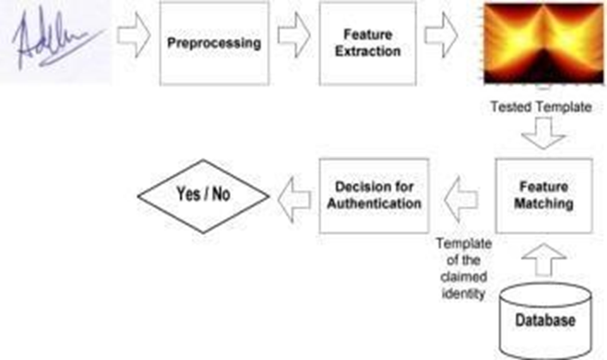
PROPOSED SYSTEM ARCHITECTURE

Slide 7
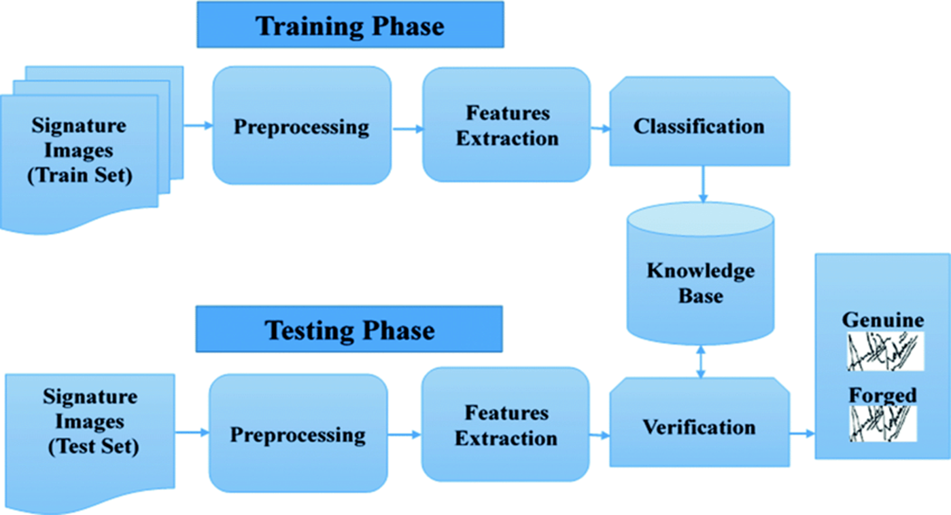
EXISTING SYSTEM ARCHITECTURE

Slide 8
SOFTWARE AND HARDWARE REQUIREMENTS
HARDWARE
SOFTWARE
512 MB RAM
2 Megapixel Camera
1 GHz Processor
Front End – html,css,python
Back End – SQLite Database, machine learning
Visual Studio Code

Slide 9
MODULES
Data Preprocessing Module
Feature Extraction Module & Feature Selection Module
Classification Module & Verification Module
Post-processing Module
Template Management Module

Slide 10
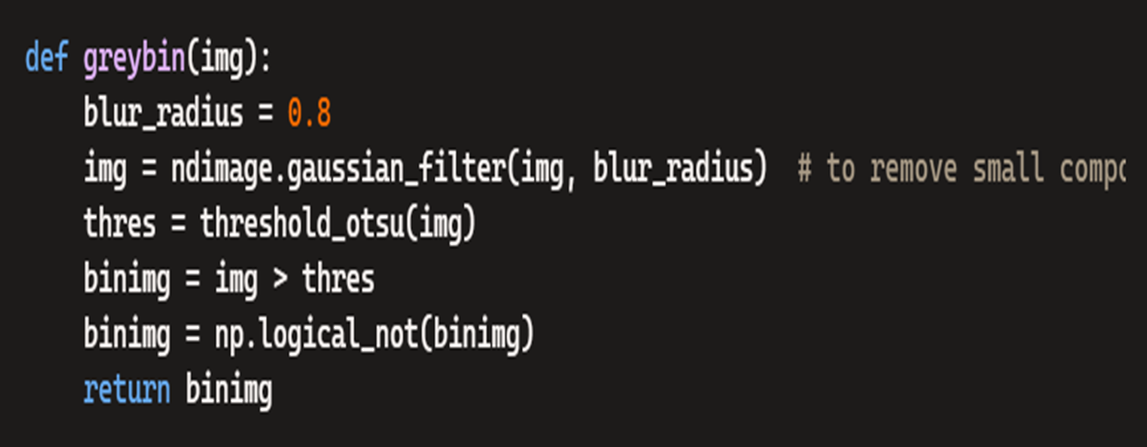
SUMMARY OF MODULE-1
DATA PREPROCESSING MODULE
Purpose: Eliminates unnecessary artifacts, such as background noise or scanning defects, that could interfere with the analysis. Standardizes the size, orientation, and resolution of signature images to ensure uniformity in processing.
Outcome: Produces a dataset free from inconsistencies and noise, ready for feature extraction. Ensures that relevant features, such as pen pressure, stroke direction, and geometric patterns, are accurately captured.

Slide 11
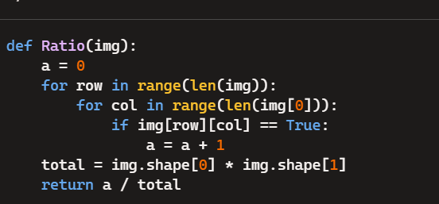
SUMMARY OF MODULE-2
FEATURE EXTRACTION MODULE:
Purpose: The primary goal is to extract key characteristics (features) from the signature, which are essential for distinguishing between genuine and forged signatures.
Outcome: The module generates a high-dimensional feature vector that represents the signature in numerical form, which can then be used for comparison with other signature samples.

Slide 12
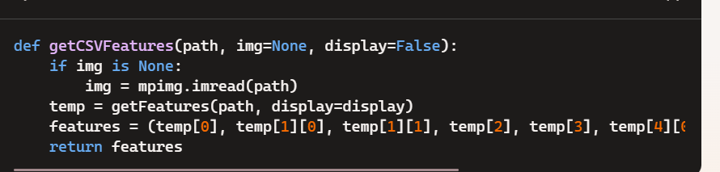
FEATURE SELECTION MODULE:
Purpose: After extracting a large number of features, this module selects the most relevant and discriminative ones, removing redundant or irrelevant data that may cause noise in the verification process.
Outcome: The module outputs a refined, reduced set of features that maintains the discriminative power of the full feature set while minimizing the computational load and improving verification accuracy.

Slide 13
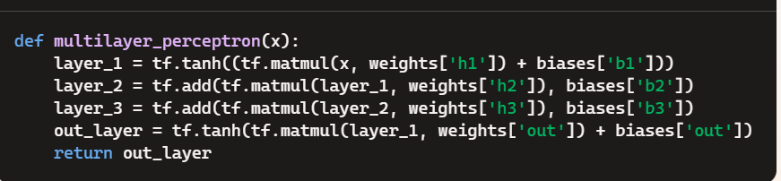
SUMMARY OF MODULE-3
CLASSIFICATION MODULE:
Purpose: The Classification Module is responsible for analyzing the extracted and selected features and classifying the signature into predefined categories, typically "genuine" or "forged".
Outcome: After training, the classification module can take an input signature, evaluate its features, and output a classification as either "genuine" or "forged.“
The classification module is represented by the neural network model defined and trained in the code. The model is a Multilayer Perceptron (MLP) that uses TensorFlow for implementation:

Slide 14
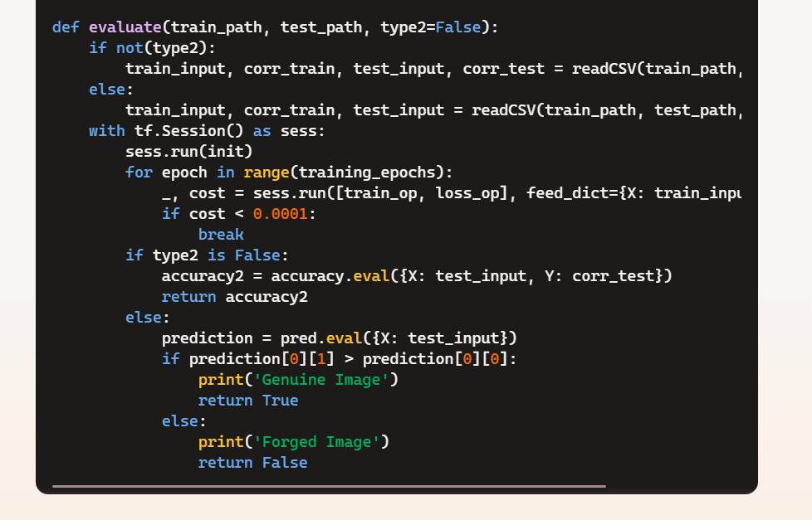
VERIFICATION MODULE:
Purpose: The Verification Module evaluates the result provided by the Classification Module and makes a final decision on the authenticity of the signature.
Outcome: The verification module either confirms the signature as genuine or flags it as a potential forgery.

Slide 15
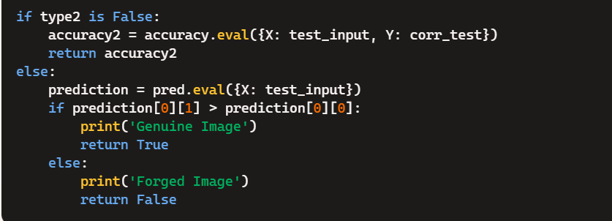
SUMMARY OF MODULE-4
POST-PROCESSING MODULE:
Purpose: The Post-processing Module refines and interprets the results from the verification process to ensure that the final decision is reliable and can be acted upon.
Outcome: The Post-processing Module outputs the final, refined decision on whether a signature is genuine or forged, often providing additional context and ensuring the result is actionable.

Slide 16
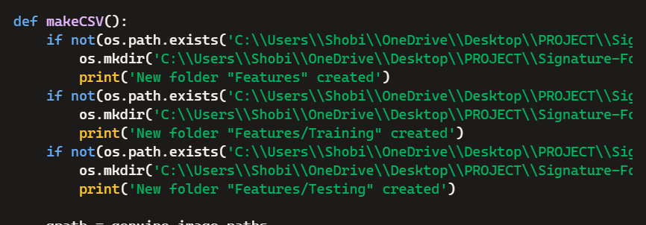
SUMMARY OF MODULE-5
TEMPLATE MANAGEMENT MODULE:
Purpose: The Template Management Module is responsible for handling and maintaining the database of reference signature templates used for comparison during verification.
Outcome: The Template Management Module ensures that only valid and up-to-date signature templates are used for verification, improving the accuracy and reliability of the system.

Slide 17
The signature verification system demonstrates a reliable approach to authenticating identities by analyzing and comparing signatures based on pre-determined metrics such as shape, pressure and stroke dynamics. The results show that the system can effectively distinguish between genuine and forged signatures, achieving high accuracy when trained with sufficient and diverse data.
RESULT AND DISSCUSSION

Slide 18
CONCLUSION
The signature verification code represents a thoughtfully constructed machine learning solution aimed at distinguishing genuine signatures from forged ones.
Each component is carefully implemented to ensure that meaningful features are extracted and effectively used for classification.
The reprocessing stage ensures the data’s quality by converting images into grayscale, applying noise reduction techniques, and cropping relevant regions to isolate the signature.
The current implementation provides a strong foundation for such future developments, showcasing the potential of combining computational techniques with practical application

Slide 19
THANK YOU

